Slide 1
UI Reporting User Interface
Ayoub Lachhab
Wako Desta

Slide 2
Agenda
1 Getting Started
2 Prerequisites
3 Sketch
4 Global Architecture
5 UI screenshot

Slide 3
1 Getting Started
We are developing the UI for Reporting User Interface

Slide 4
Prerequisites
2.1 Node.js
You can Download from this link :
https://nodejs.org/en/download/
2.3 Integrated development environment I suggest WebStorm Or Visual Studio.
Download WebStorm
https://www.jetbrains.com/webstorm/download/#section=windows
Download Visual studio code:
https://code.visualstudio.com/download

Slide 5
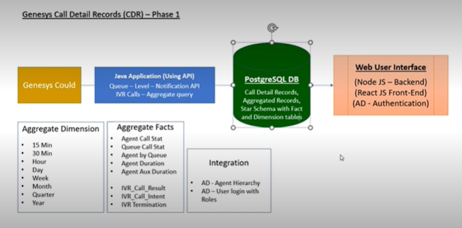
Global Architecture

Slide 6
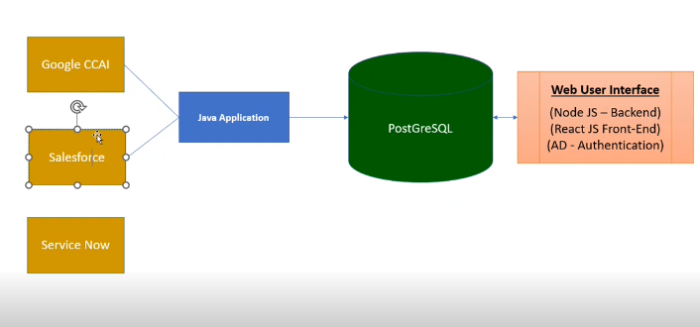

Slide 7
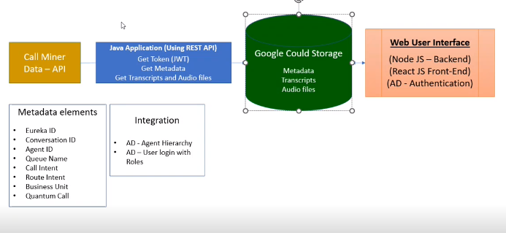

Slide 8
UI screenshot

